Slide 1


Slide 2
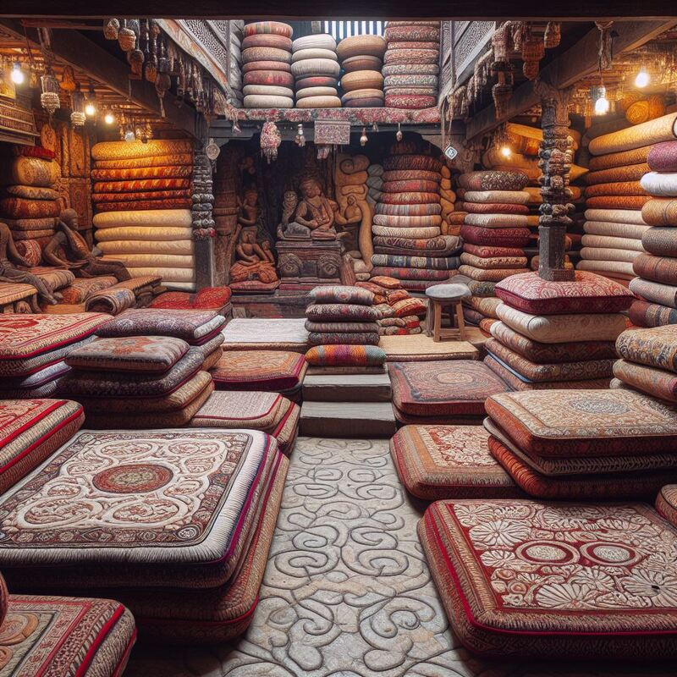
Table of Content
1.Introduction…………………………………………………………….3
2.Objectives ……………………………………………………………..4
3.Requirement Analysis ………………………………………………..5
4.Use case diagram……………………………………………………..6
5.Data Modeling ( ER diagram)……………………………………….7
6.Process Modeling(DFD)
6.1 DFD Level 0………………………………………………………..8
6.2 DFD Level 1 …………………………………………………........9
7.System Design……………………………………………….......…...10
7.1Architecture Design……………………………………………..11
7.2 Database Schema Design…………………………………….12
7.3 Physical DFD…………………………………………………......13
8. Tools Used……………………………………………………………..14
9.Screenshots of Galaicha Nepal…………………………………...15
10. Conclusion…………………………………………………………..22
11. References ………………………………………………………….23

Slide 3

Introduction
Galaicha Nepal E-commerce Platform is a user-centric e-commerce platform, allowing customers to sign up or log in to the website to access a wide range of mattress options. With intuitive navigation and user-friendly interfaces, customers can easily browse through product listings, view detailed descriptions, and place orders with just a few clicks.
In summary, the Galaicha E-commerce Platform represents a significant leap forward in the way mattresses are bought and sold in Nepal. By leveraging the power of technology and catering to modern consumer preferences, the platform aims to provide a convenient, transparent, and reliable shopping experience for users while empowering administrators with efficient backend management tools

Slide 4
Objectives
Streamlining the organization and retrieval of essential information related to item categories, product listings, orders, and user accounts.
Empowering administrators with comprehensive access and management capabilities to oversee item categories, product listings, and user accounts efficiently.
To develop an application program aimed at simplifying the management of Galaicha item categories for consumers.

Slide 5
Requirement Analysis
Functional Requirement | Non-Functional Requirement
User Registration and Login Product Display Online Ordering | Responsive design Speed and Performance Security User Experience

Slide 6
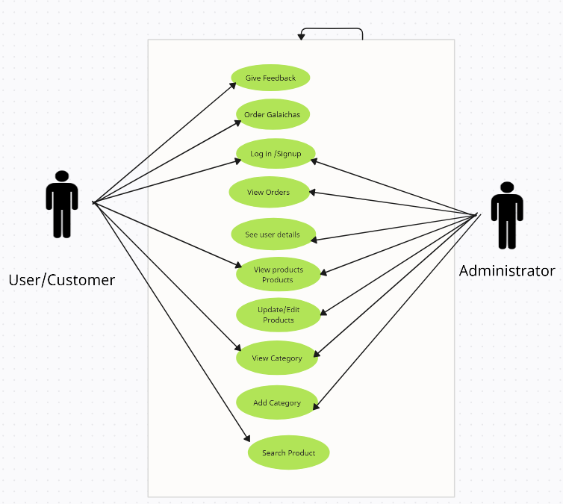
Use Case Diagram
We create use case diagrams to visually represent the functional requirements of a system, showing how users interact with various system components.

Slide 7
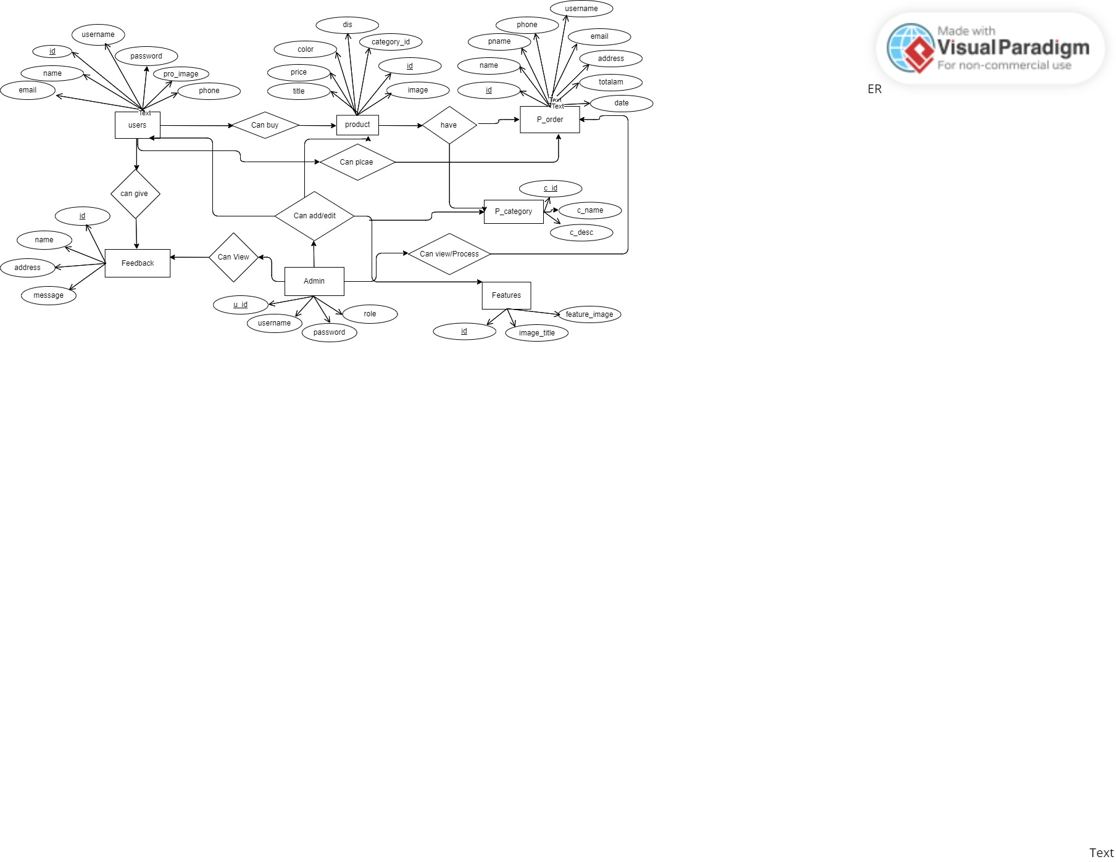
Data Modeling(ER Modeling)
An Entity-Relationship (ER) diagram is a visual representation used in database design to illustrate the logical structure of a database. It depicts entities (objects or concepts), attributes (properties of entities), and relationships (connections between entities).

Slide 8
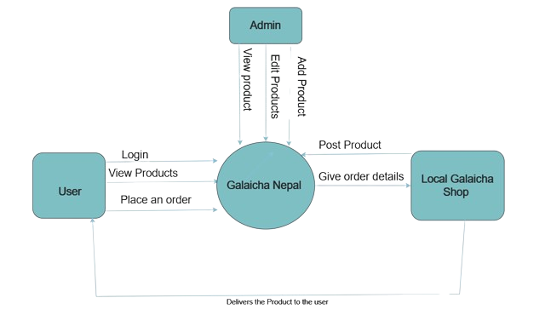
Process Modeling
Data Flow Diagram Level 0
We create a Level 0 data flow diagram to provide a high-level overview of a system's processes and data flows, illustrating the system's major functions and their interactions.

Slide 9
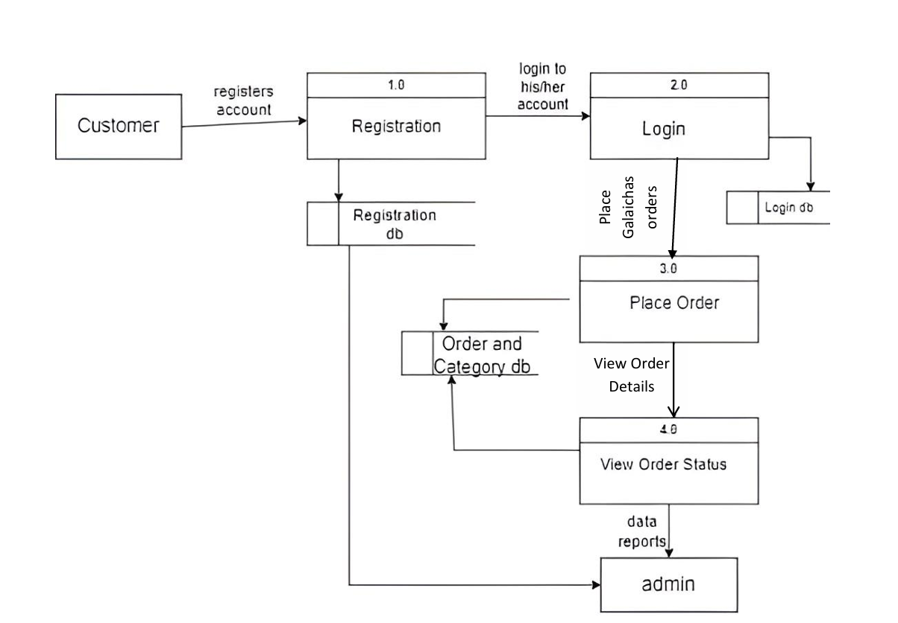
Process Modeling
Data Flow Diagram Level 1
We create a Level 1 data flow diagram to break down the high-level processes from Level 0 into more detailed sub-processes, showing a more granular view of the system's data flows and interactions

Slide 10
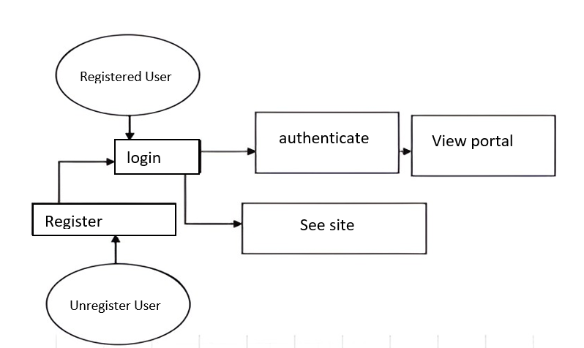
System Design

Slide 11
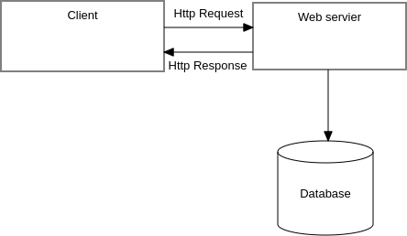
Architecture Design
System Design
Web Server

Slide 12
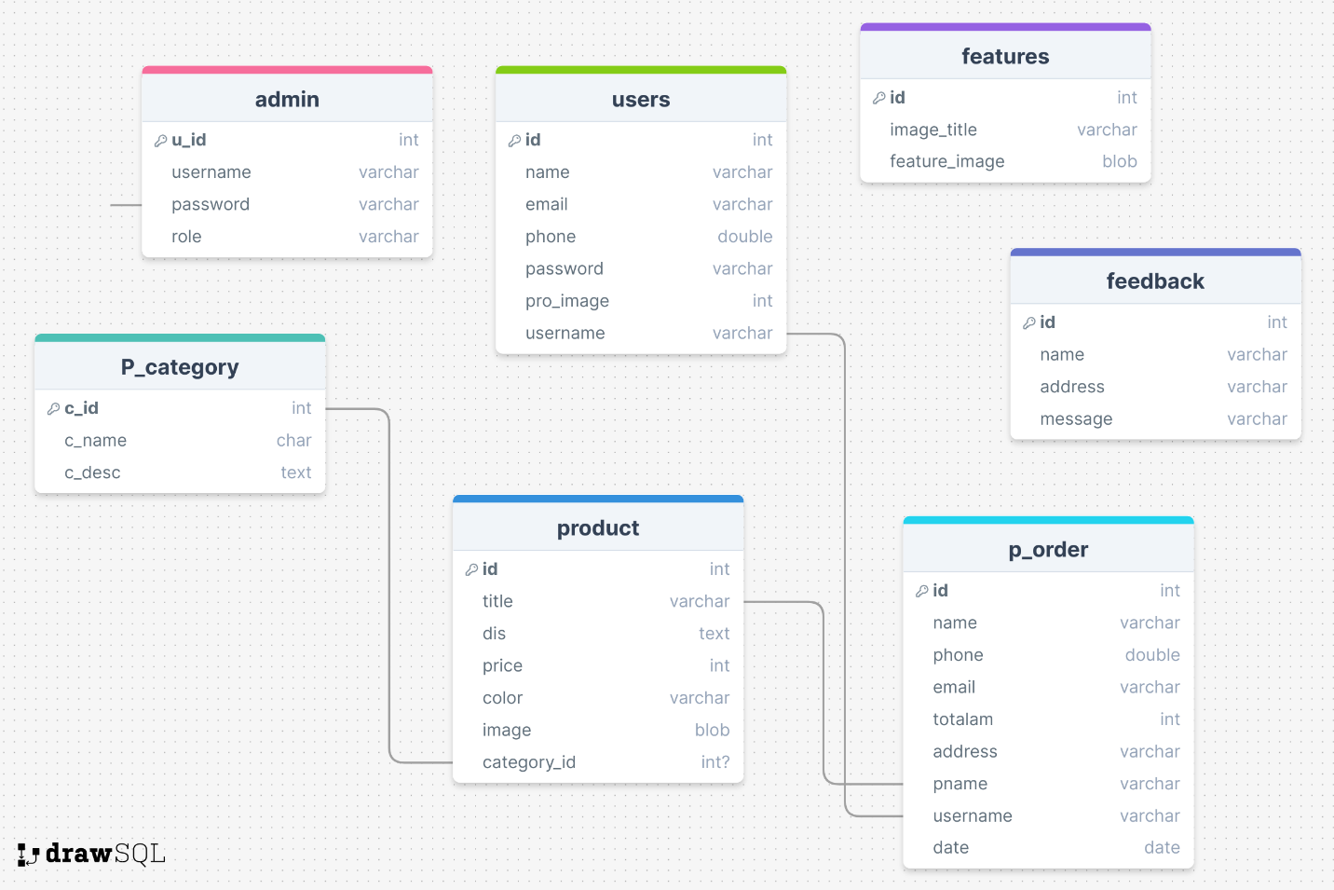
Database Schema Design
System Design

Slide 13
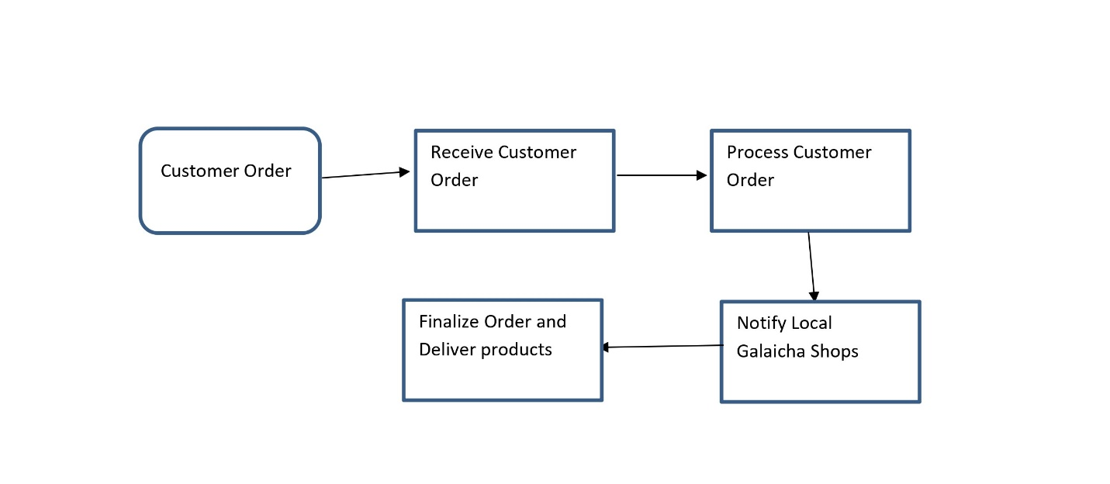
Physical DFD
System Design

Slide 14
Tools Used
Case tools | Programming language | Database Platform
Visual Paradigm Visual Studio Code Draw.io | HTML CSS PHP Js JQuery AJAX | My Sql

Slide 15
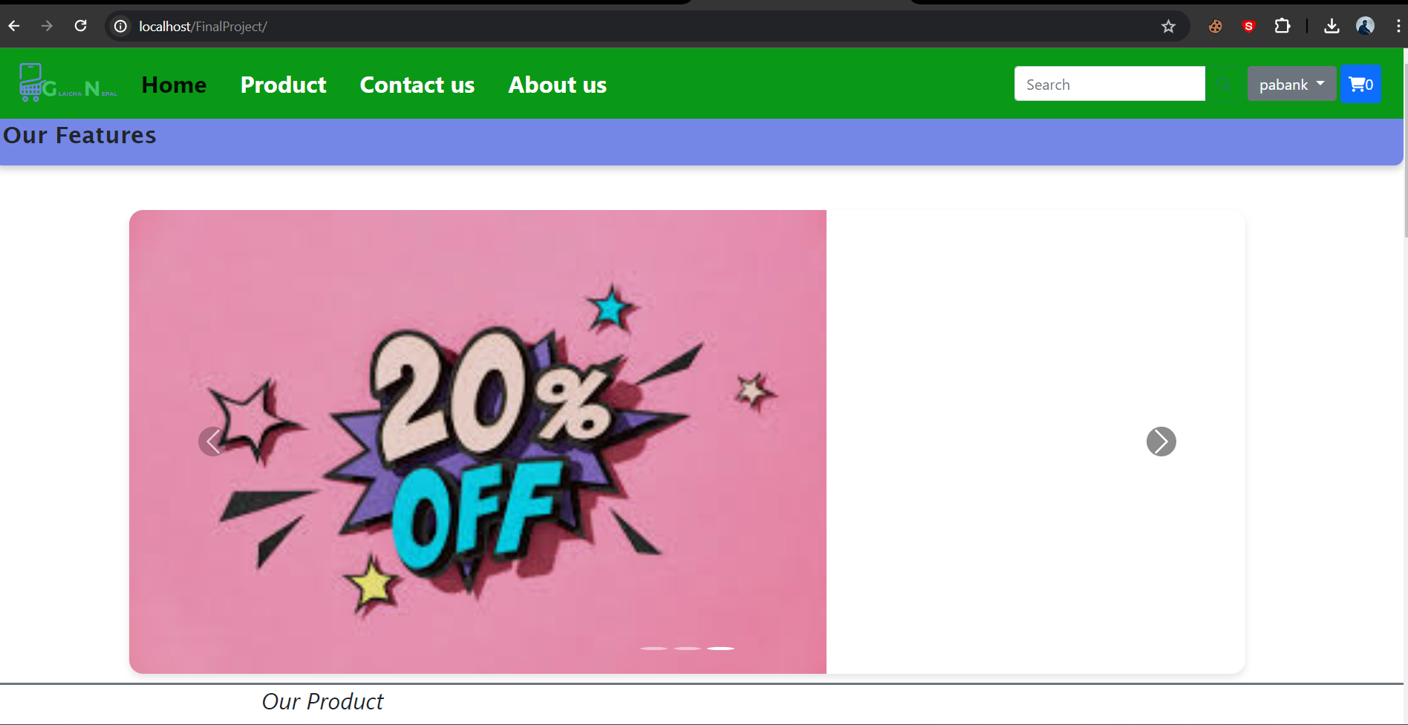
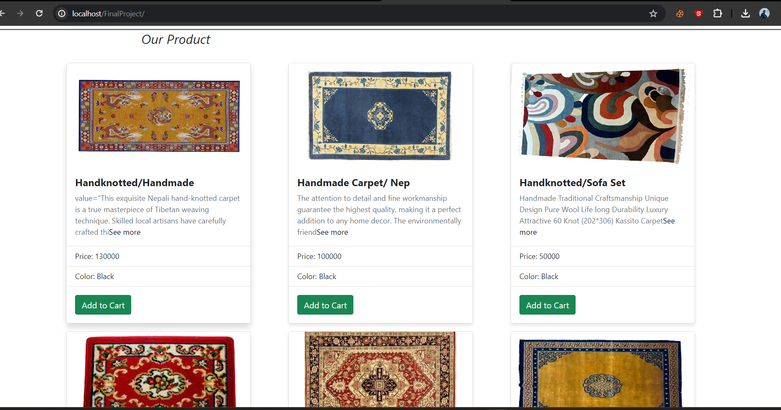
Home Page

Slide 16
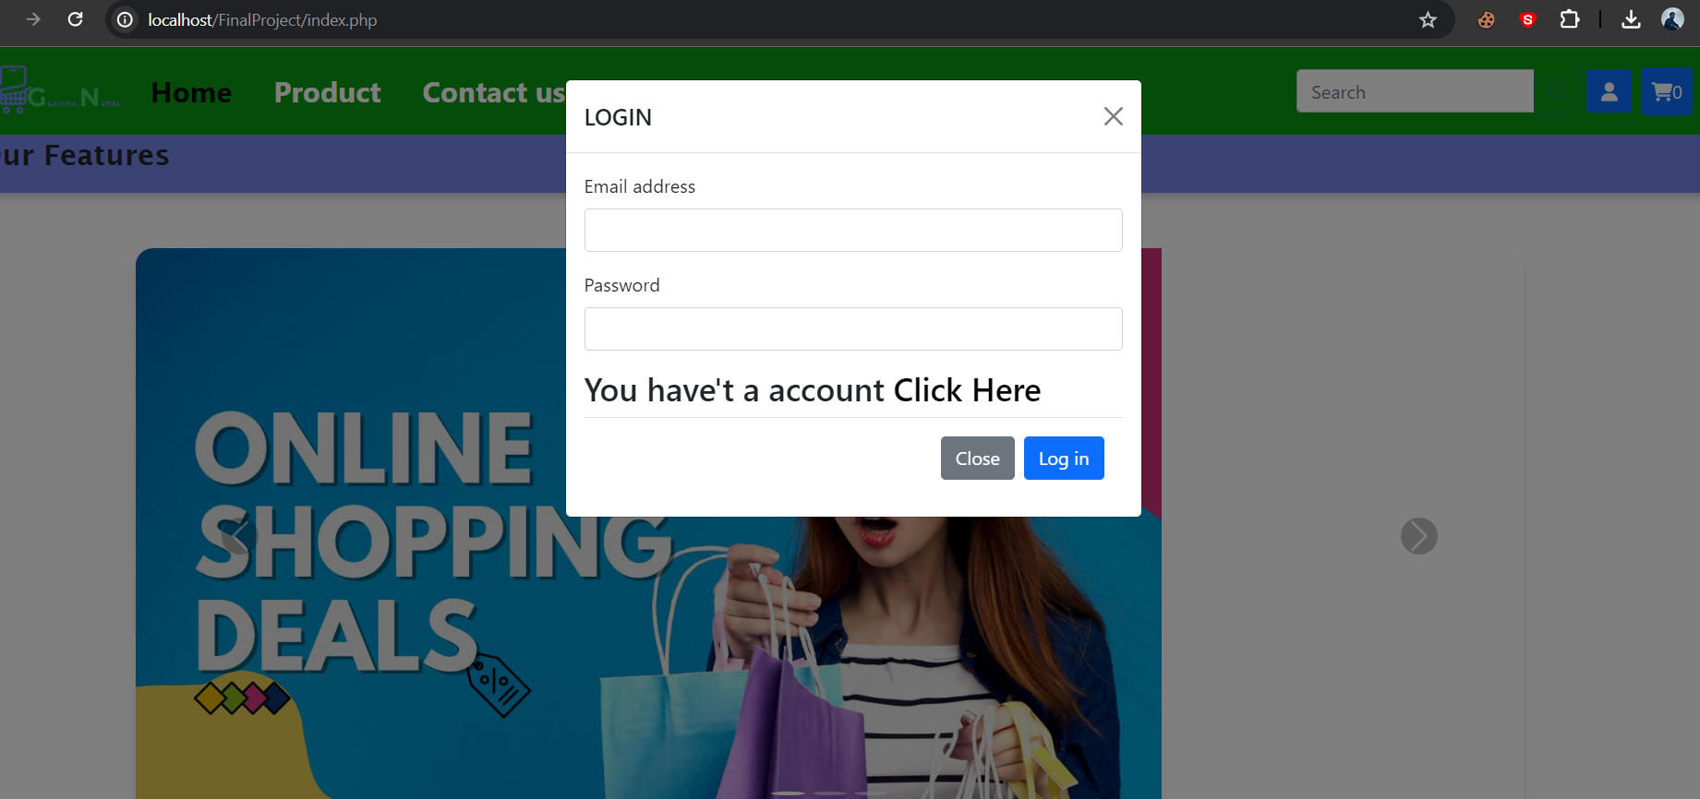
Login Page

Slide 17
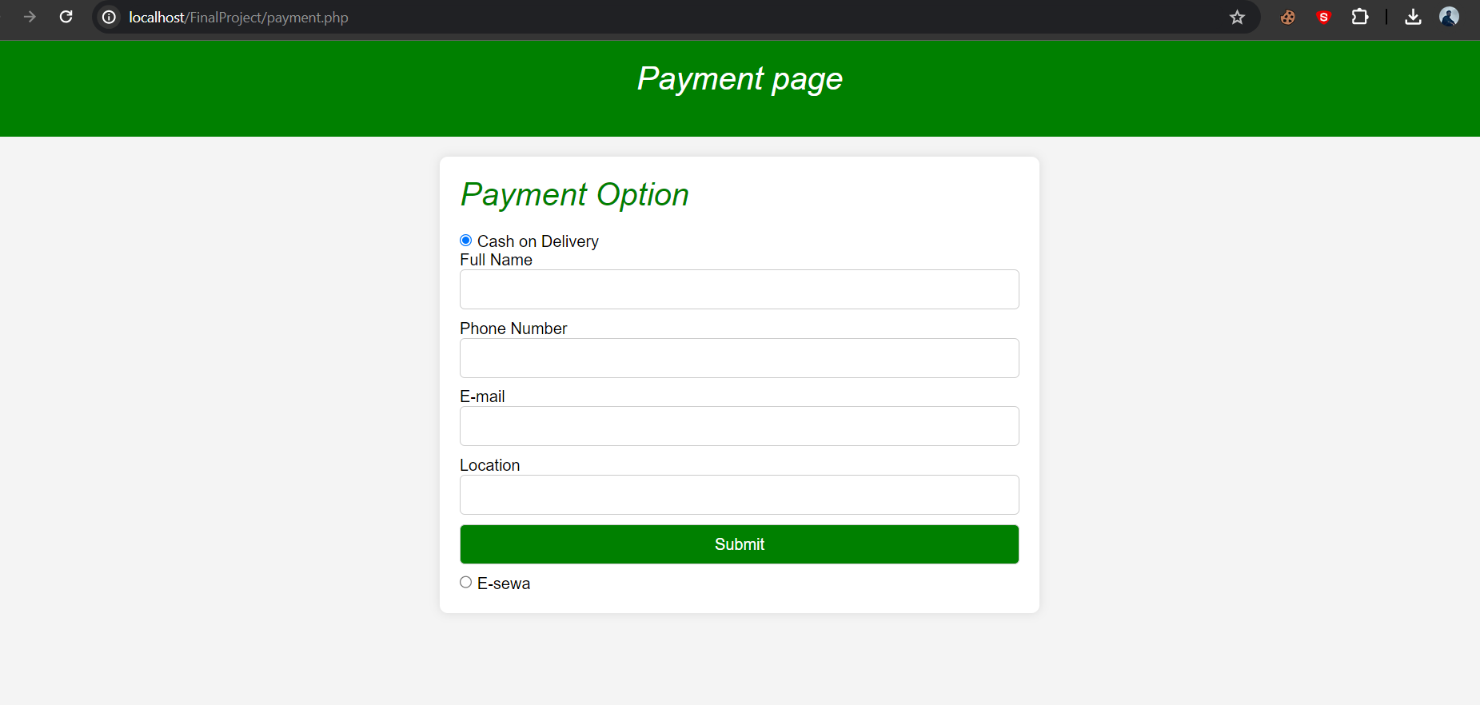
Order Page / Payment Page

Slide 18
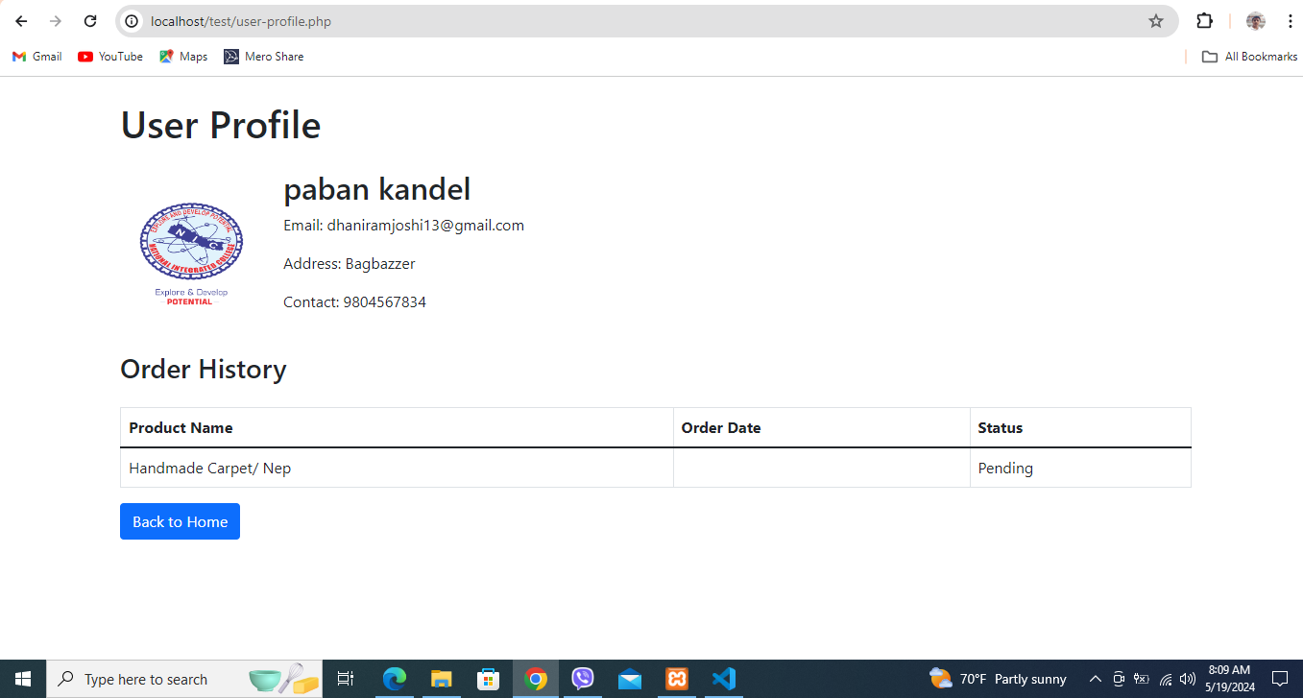
Profile of User

Slide 19
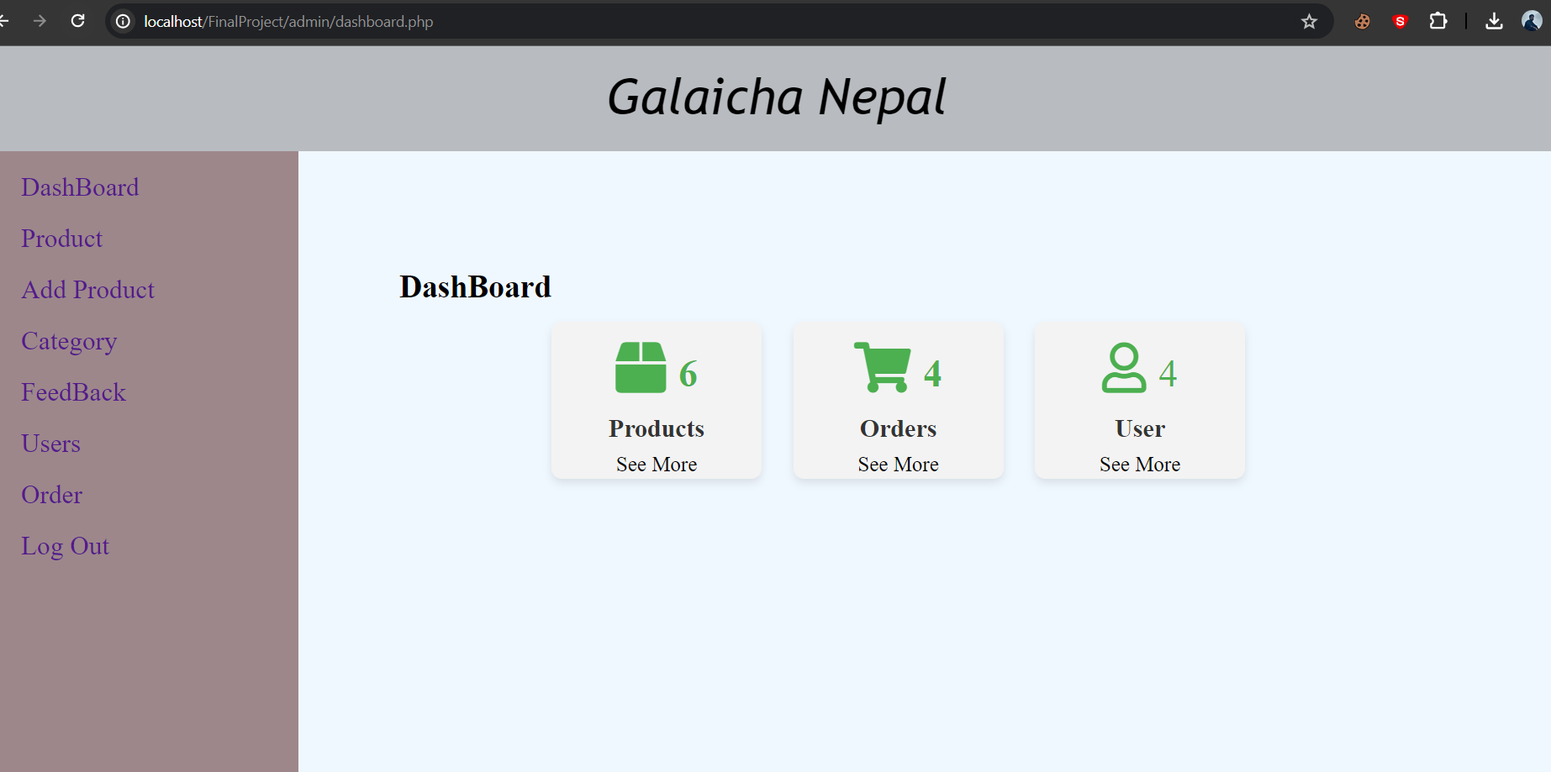
Admin Dashboard

Slide 20
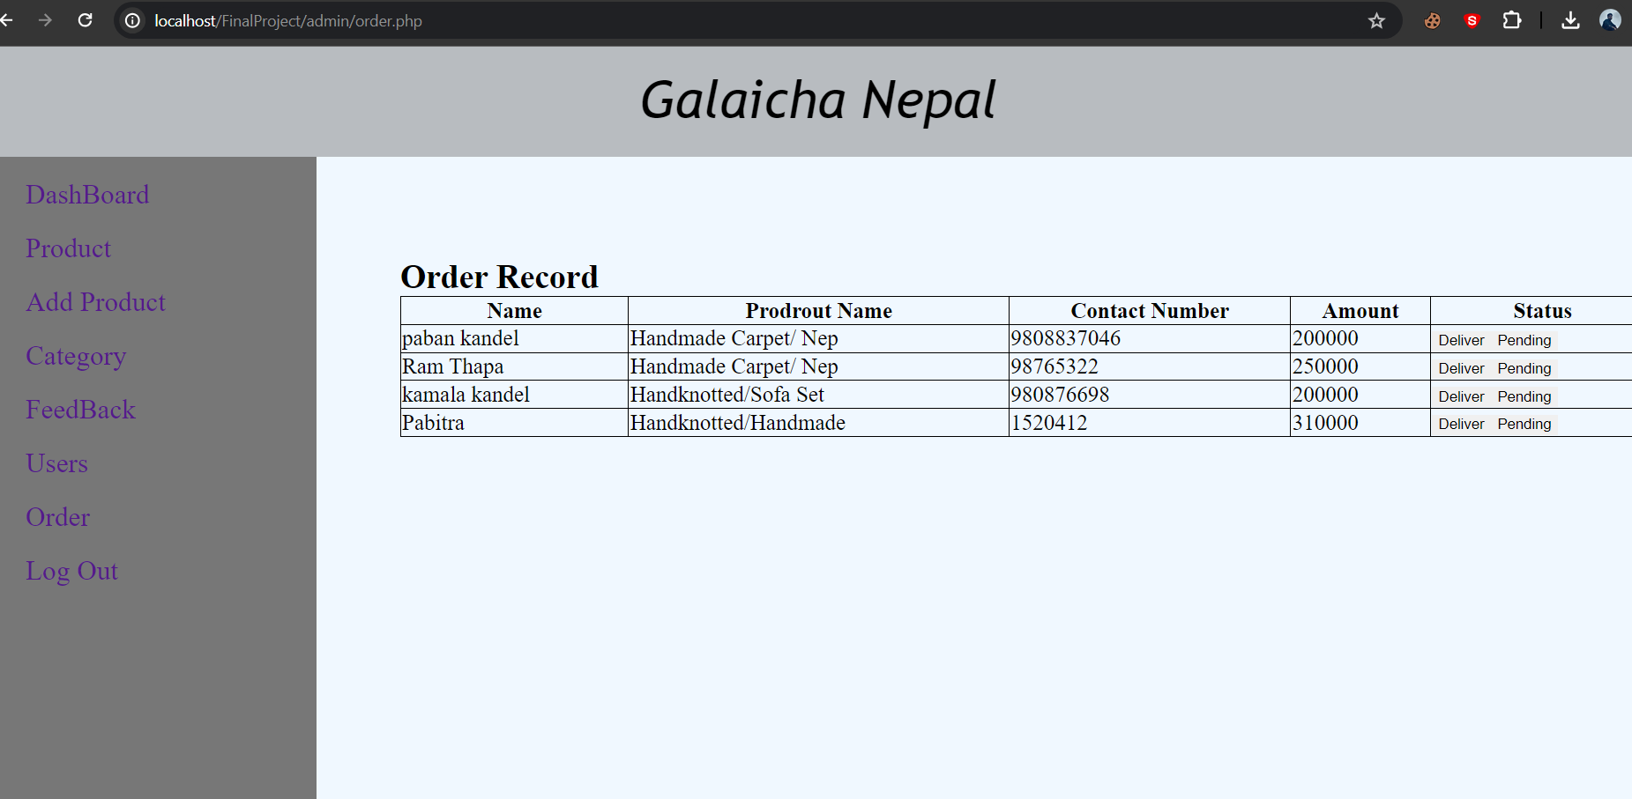
Orders

Slide 21
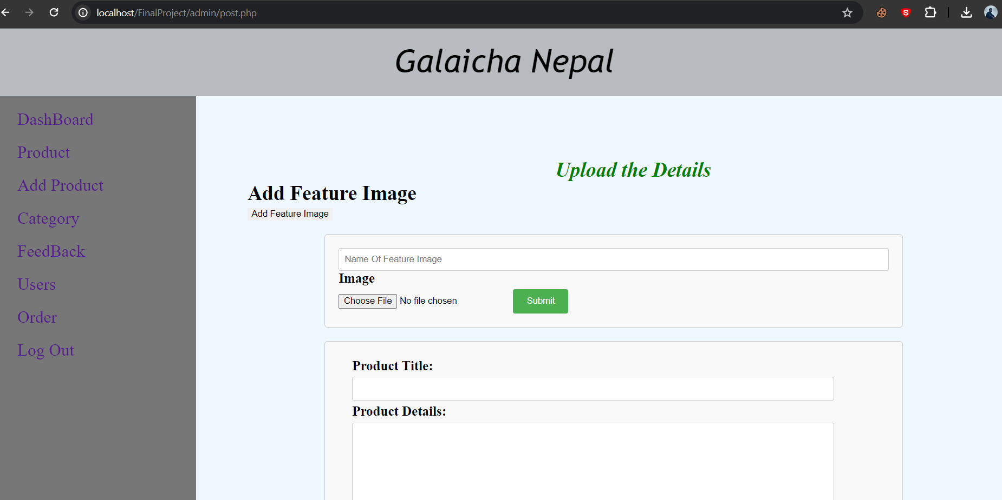
Add Product

Slide 22
Conclusion
The Galaicha Nepal E-commerce Platform endeavors to redefine the Galaicha landscape by introducing a pioneering digital platform that connects customers with authentic Galaicha suppliers seamlessly. By harnessing cutting-edge technologies, enhancing user experiences, and empowering both customers and administrators, Galaicha Nepal is dedicated to enhancing efficiency, convenience, and overall performance within the Galaicha market. This project embodies a concerted endeavor to transform the Galaicha shopping experience, with the ultimate aim of ensuring that each purchase results in a delightful journey for customers. This study delves into the opportunities and challenges of Galaicha e-commerce in Nepal's evolving digital landscape. It provides insights into consumer behavior, technological advancements, and market dynamics, offering valuable recommendations for Galaicha Nepal's strategic development.

Slide 23
References
. Gurung, B., et al. (2021). "Consumer Preferences and Purchasing Behavior in the Nepali Mattress Market." Journal of Consumer Studies, 30(4), 212-225.
Rai, A., et al. (2018). "Technological Innovations and Market Disruptions: Implications for Galaicha E-commerce in Nepal." International Journal of Innovation Management, 25(1), 34-48.
Thapa, P., et al. (2017). "Challenges of Digital Transformation in Nepali Retail: Lessons for Galaicha E-commerce." Journal of Retail Management, 20(2), 89-104.
Sharma, S., et al. (2019). "E-commerce Trends in Nepal: Opportunities and Challenges." International Journal of Business Management, 15(3), 78-92.
Shakya, R., et al. (2016). "Digital Commerce Adoption in Nepal: Implications for Galaicha E-commerce." Journal of Business and Technology, 18(1), 56-70.
Joshi, A., et al. (2018). "Innovative Technologies and Galaicha E-commerce: A Case Study of Nepali Retailers." Journal of Innovation Management, 22(4), 112-125.
Khadka, N., et al. (2015). "Adoption of E-commerce in Nepal: Insights for Galaicha Retailers." International Journal of Retailing, 12(3), 78-91.
Bhandari, S., et al. (2020). "Cultural Significance and Market Potential of Galaicha in Nepal." Journal of Cultural Heritage Management, 10(2), 145-160.
Thapa, N., & Rai, A. (2022). "Harnessing Mobile Technologies for Galaicha Retail: A Case Study of User Adoption and Satisfaction." International Journal of Mobile Commerce, 15(3), 145-160.
Gurung, S., & Tamang, R. (2023). "Exploring the Digital Landscape: Opportunities and Challenges for Galaicha E-commerce in Nepal." Journal of Digital Innovation, 8(2), 112-125.

Slide 24
Thank You !!!

